Slide 1

Signal and Systems
(ET 8211)
Department of Electronics and Telecommunication Engineering
Mbeya University of Science and Technology
Email : cnyatega@mustnet.ac.tz
Mobile : 0742100004

Slide 2
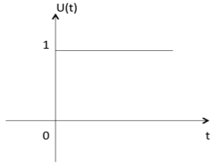
Signals Basic Types
Here are a few basic signals:
a) Unit Step Function
Unit step function is denoted by u(t).
It is defined as:
u(t) = {1 t>=0
{0 t< 0
It is used as best test signal.
Area under unit step function is unity.

Slide 3
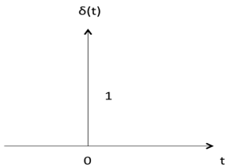
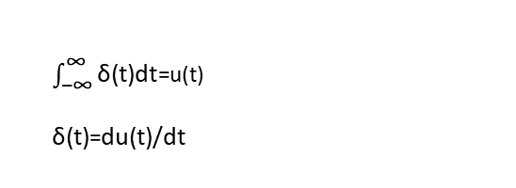
b) Unit Impulse Function
Impulse function is denoted by δ(t).
it is defined as:
δ(t) = {1 t=0
{0 t ≠0
$\int_{\text{−∞}}^{\text{∞}}{\text{δ}\text{(}\text{t}\text{)}\text{dt}}$=u(t)
δ(t)=$\text{du}\text{(}\text{t}\text{)/}\text{dt}$

Slide 4

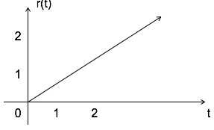
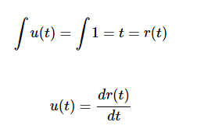
Ramp Signal
Ramp signal is denoted by r(t), it is defined as
Area under unit ramp is unity.

Slide 5
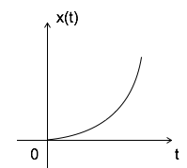

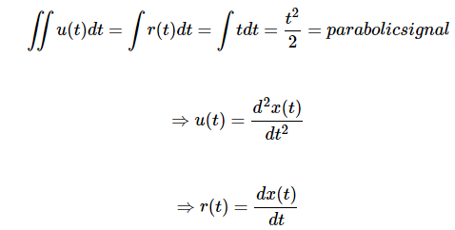
Parabolic Signal
Parabolic signal can be defined as:

Slide 6

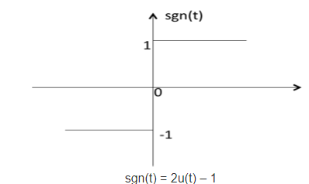
Signum Function
Signum function is denoted as sgn(t).
It is defined as:

Slide 7

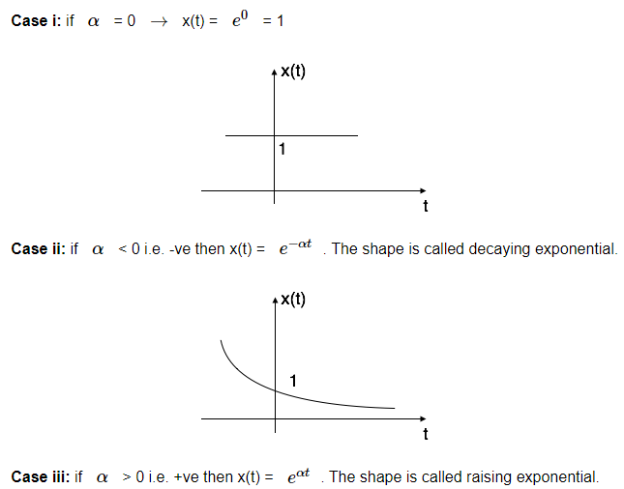
Exponential Signal
Exponential signal is in the form of

Slide 8
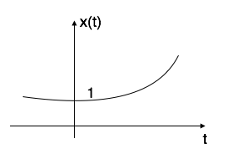
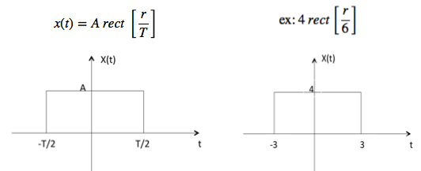
Rectangular Signal
Let it be denoted as x(t) and it is defined as

Slide 9
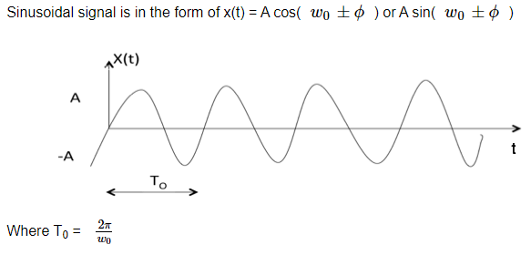
Sinusoidal Signal

Slide 10
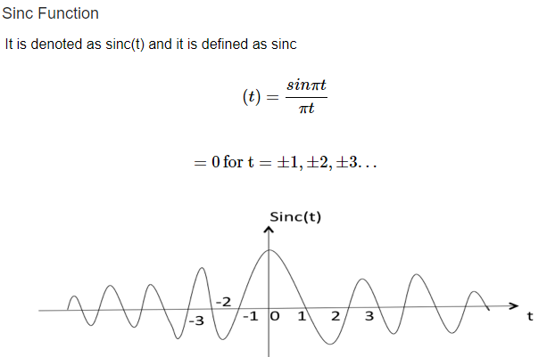

Slide 11
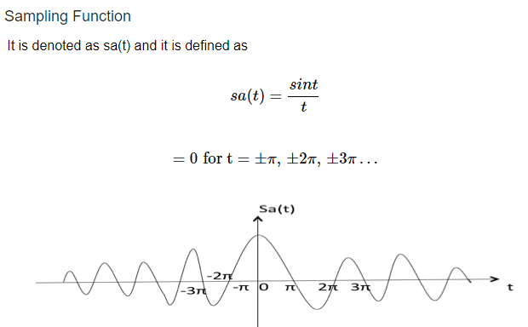

Slide 12
Signals Classification
Signals are classified into the following categories:
Continuous Time and Discrete Time Signals
Deterministic and Non-deterministic Signals
Even and Odd Signals
Periodic and Aperiodic Signals
Energy and Power Signals
Real and Imaginary Signals
Continuous Time and Discrete Time Signals
A signal is said to be continuous when it is defined for all instants of time

Slide 13
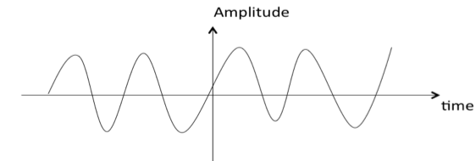
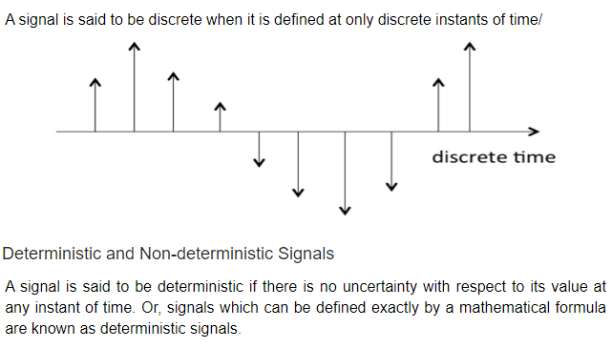

Slide 14
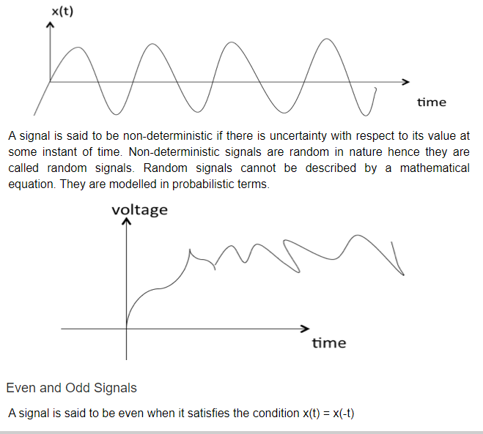

Slide 15
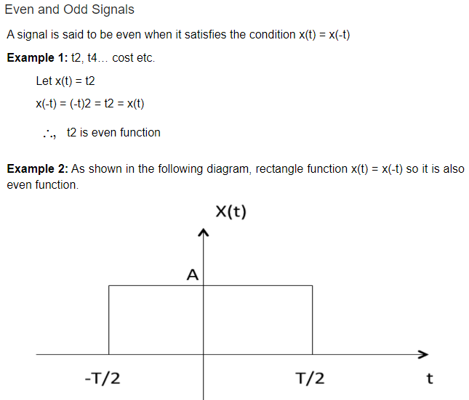

Slide 16
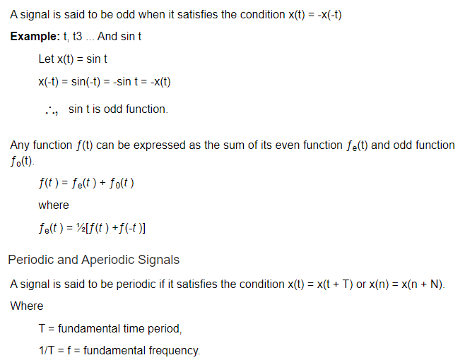

Slide 17
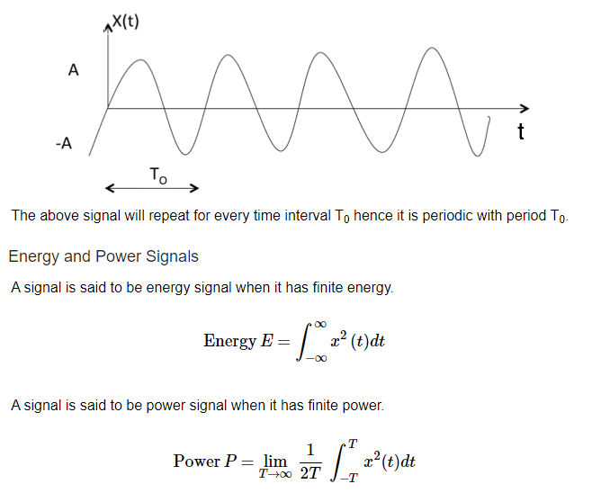

Slide 18
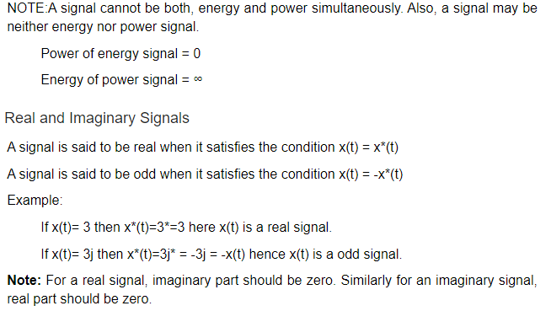

Slide 19
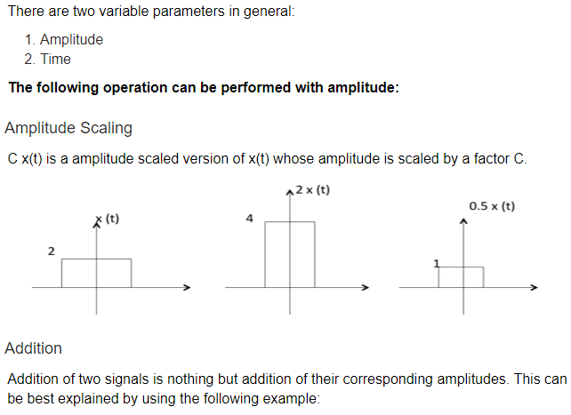
Signals Basic Operations

Slide 20
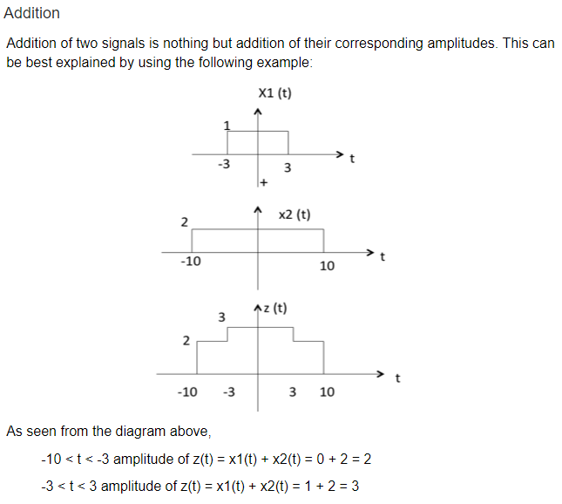

Slide 21
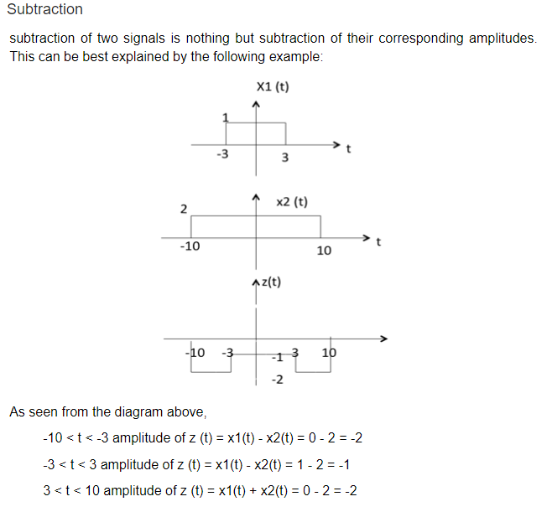

Slide 22
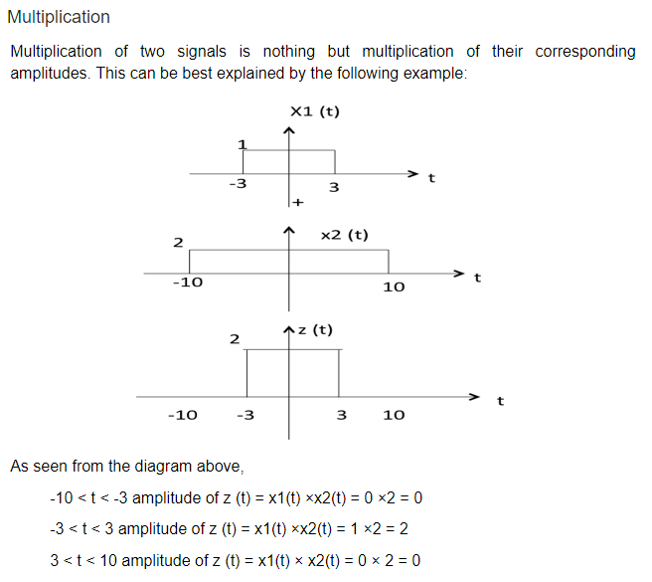

Slide 23
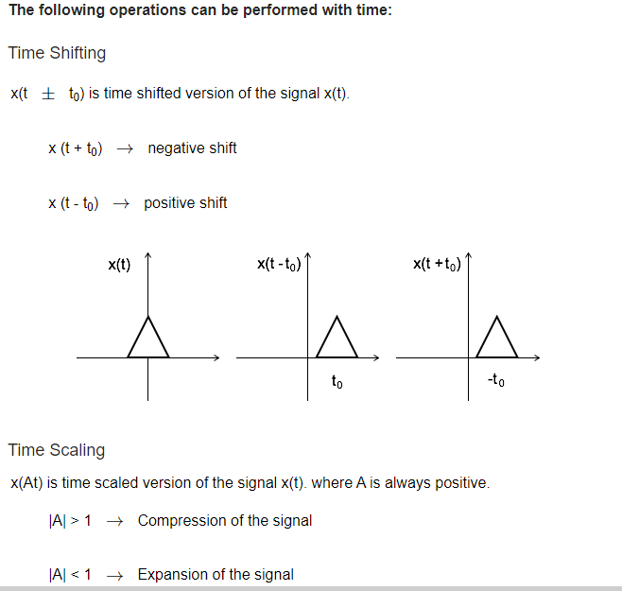

Slide 24
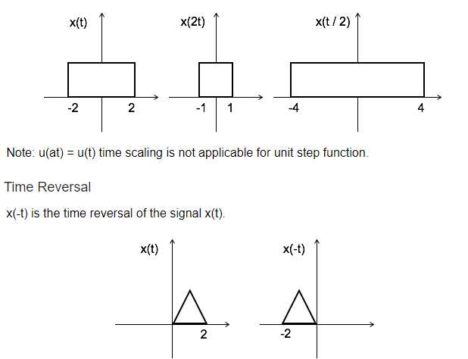

Slide 25
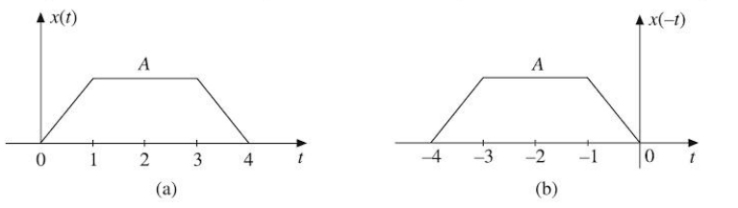

Slide 26
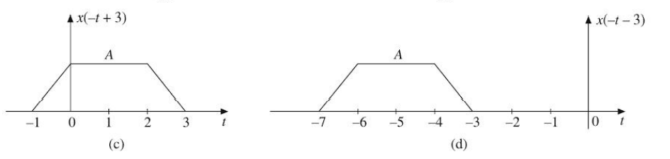

Slide 27
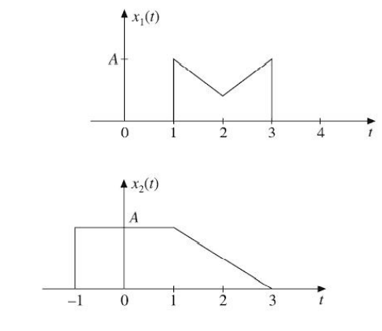
Draw time Reversal of the following Signals

Slide 28
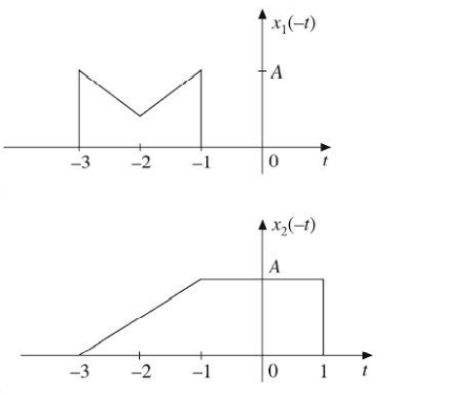
Answers

Slide 29
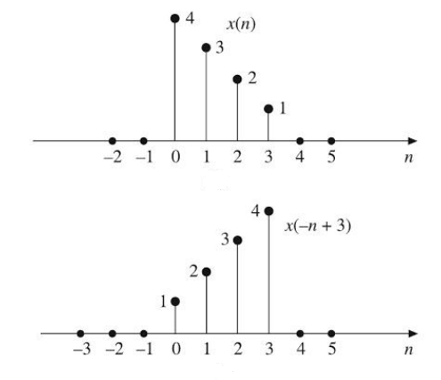
Draw time reversal of the following discrete signals

Slide 30
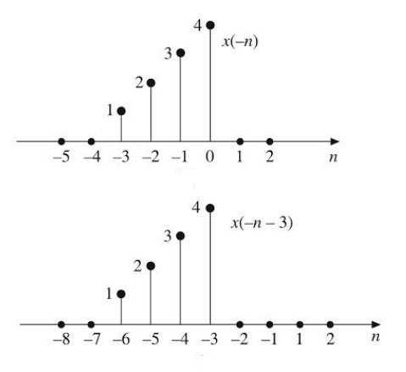
Answers

Slide 31
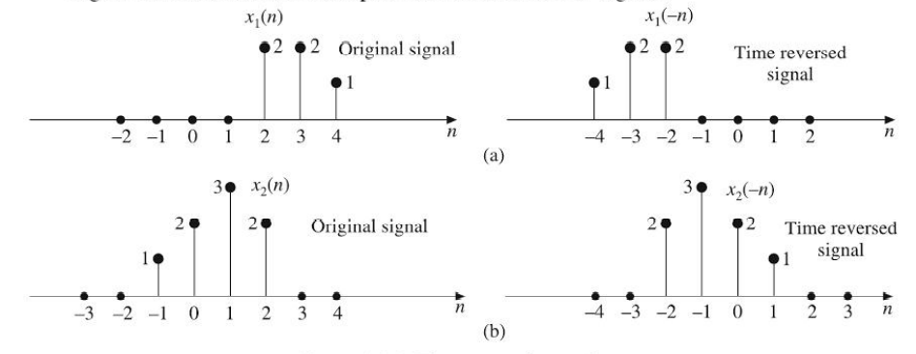
Other examples

Slide 32


Sketch the following signals

Slide 33
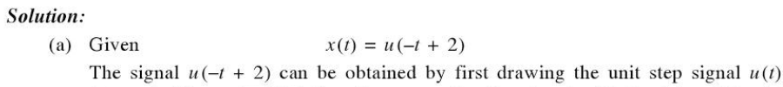
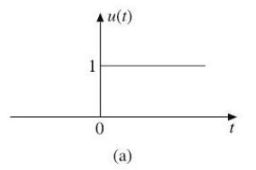
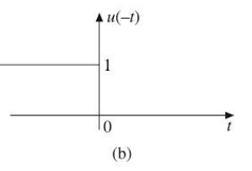

Slide 34
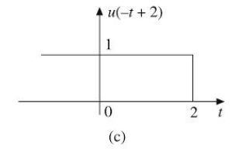

Slide 35
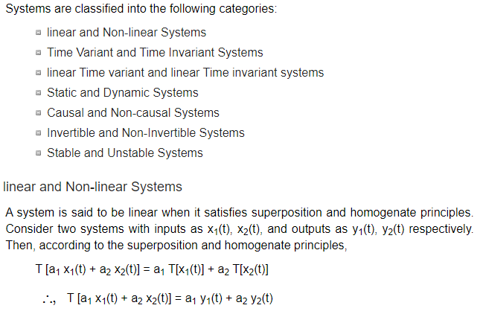
Systems Classification
.
From the above expression, is clear that response of overall system is equal to response of individual system

Slide 36
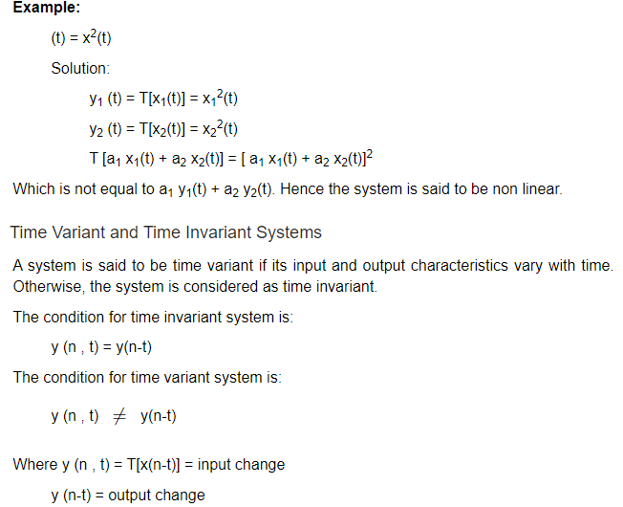

Slide 37
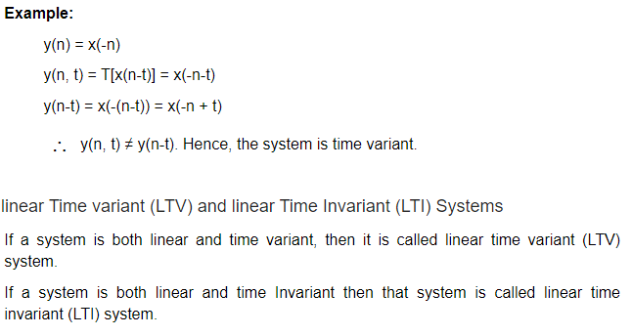

Slide 38
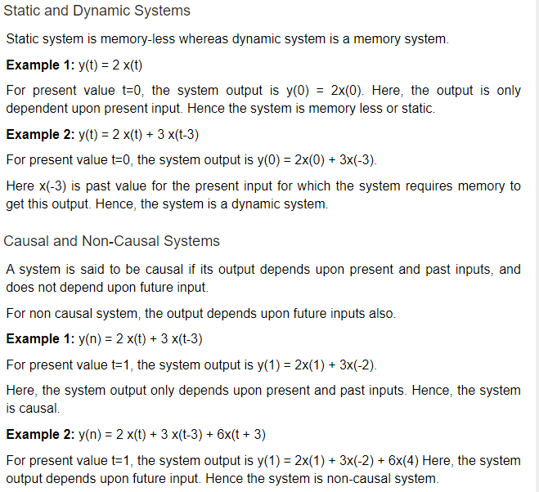

Slide 39
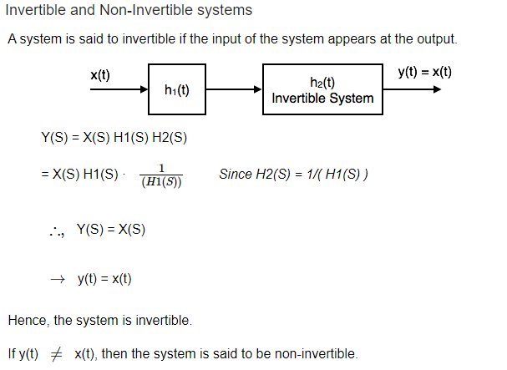

Slide 40
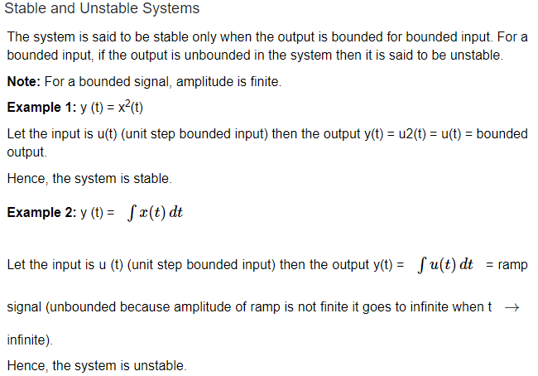

Slide 41
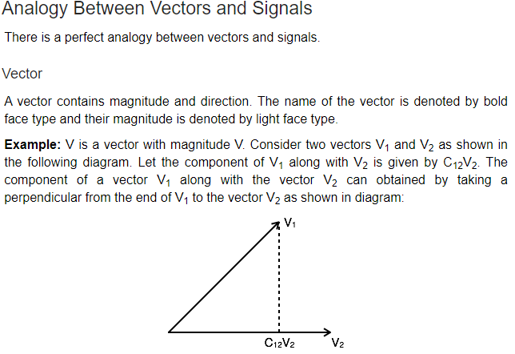
Signals Analysis

Slide 42
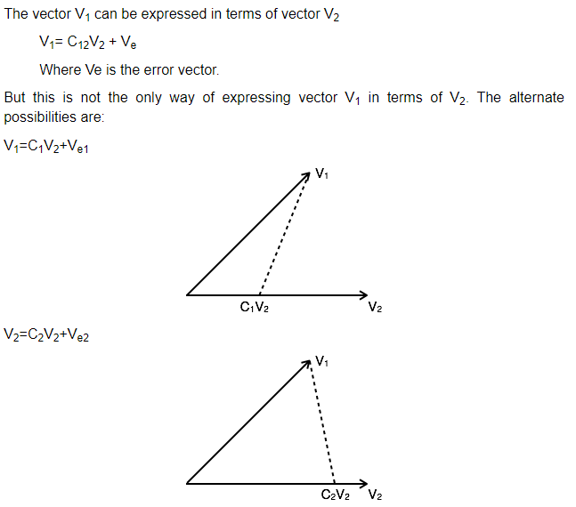

Slide 43
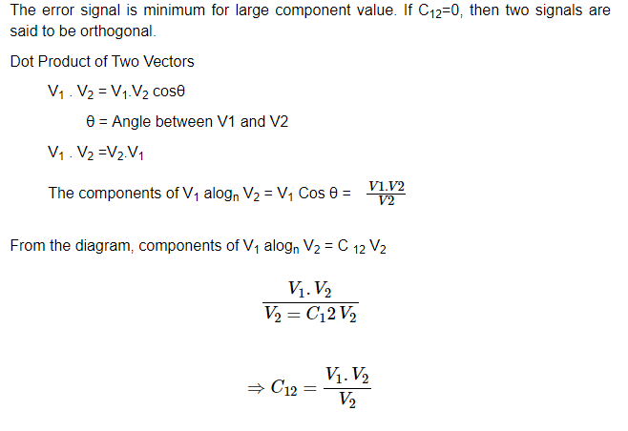

Slide 44
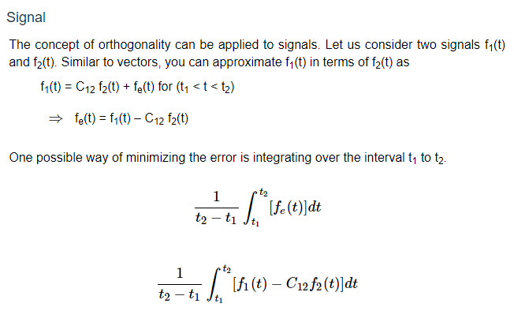

Slide 45
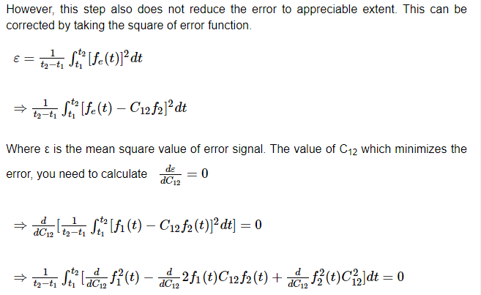

Slide 46
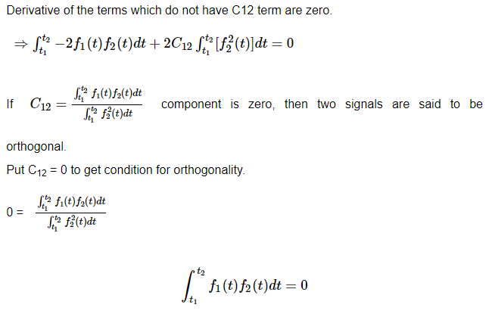

Slide 47


Slide 48


Slide 49


Slide 50


Slide 51


Slide 52


Slide 53

Fourier Series

Slide 54


Slide 55


Slide 56


Slide 57


Slide 58

FOURIER SERIES PROPERTIES

Slide 59


Slide 60


Slide 61


Slide 62

FOURIER TRANSFORMS

Slide 63


Slide 64


Slide 65


